Slide 1
Convolutional Neural Network

Slide 2
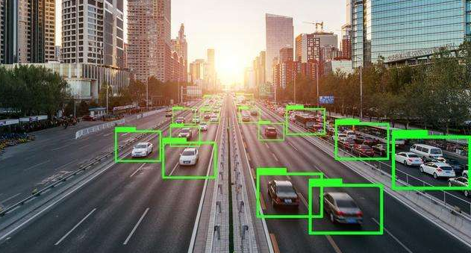
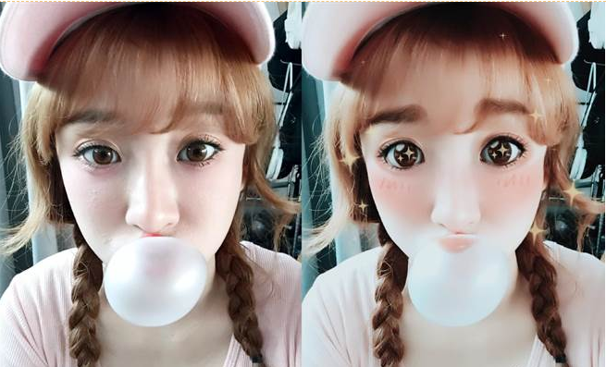
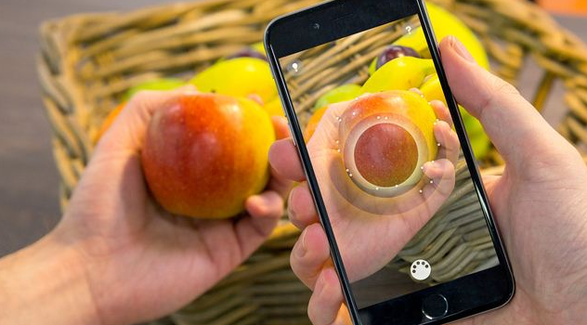

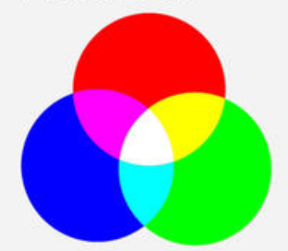
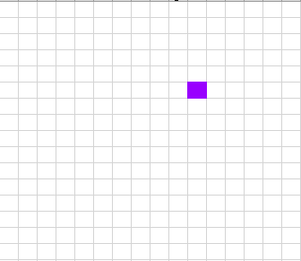
Before Course
Why we need to learn CNN:
Computer vision is a widely application field:
Image classification
Object detection
Object localization
Semantic segmentation
Instance segmentation
Facial recognition
Composition of pictures
https://i1.kknews.cc/SIG=lmeklr/ctp-vzntr/154003333228211945o642q.jpg
https://www.irishtimes.com/polopoly_fs/1.3490552.1525968898!/image/image.jpg_gen/derivatives/box_620_330/image.jpg
https://images.chinatimes.com/newsphoto/2016-10-05/900/20161005005096.jpg
RGB:
Red
Green
Blue
Red: 153
Green:0
Blue:255
https://pic.17qq.com/uploads/wacrrthqrx.jpeg
The color value of each pixel is represented by a color combination of red, green and blue, which is known as computer three primary colors.
A picture in the computer is just like a cross embroidery, composed of an array of colored dots(pixel).
So a picture in the computer is recorded as a table(matrix) of pixels which are represented by color value combinations.

Slide 3
Objectives
Upon completing this course, you will understand:
Basic knowledge of CNNs
Concepts of convolution, pooling
Mainstream CNN models
Hands-on using LeNet5 to identify handwritten numbers

Slide 4
Contents
Convolution
Pooling
LeNet 5
Other mainstream CNN models

Slide 5
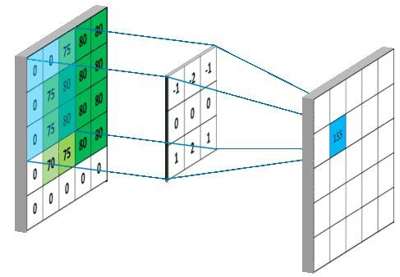
Convolution – Introduction
Convolution is a fundamental building of convolutional neural networks (CNNs).
Convolution is like a sliding window that slides from left to right or from top to bottom. (In this section, we focus exclusively on two-dimensional convolution operations.)
Each time the window slides from one point to another, a weighted mean value is obtained.
It focuses on a small piece of data or local data.
input1
input2
output
Convolutional kernel
(filter)
Before transformed
After transformed
input1
convolution
output
input2

Slide 6
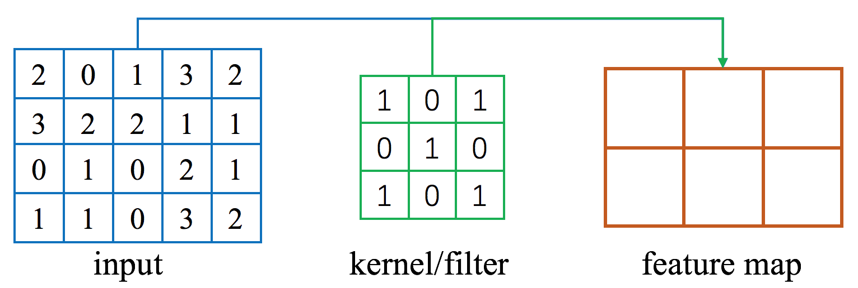
Convolution – Components
Components
Input matrix
Kernel matrix (or filter)
Given an input matrix, we can obtain the desired output matrix (also known as a feature map) by sliding the kernel matrix on the input matrix.

Slide 7
Convolution – Calculation
1
0
1
The number of each corresponding position are multiplied and then added up together.
Slide the kernel matrix from left to right, from top to bottom.
0
1
0
1
0
1
2
0
1
3
2
2
0
1
3
2
5
5
8
5
3
2
2
1
1
3
2
2
1
1
0
1
0
2
1
0
1
0
2
1
1
1
0
3
2
1
1
0
3
2
(a)
(b)
2
0
1
3
2
5
8
5
2
0
1
3
2
5
8
5
3
2
2
1
1
3
2
2
1
1
0
1
0
2
1
7
7
0
1
0
2
1
7
7
7
1
1
0
3
2
1
1
0
3
2
(c)
(d)

Slide 8
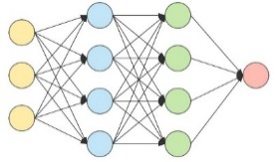
Convolution – Characteristics
Each output corresponds to a local feature of a small part of the input matrix.
The output 2×3 matrix shares the same kernel matrix, which is also known as parameter sharing.
If the full-connection operation is used, a 20×6≫3×3 matrix is required.
The convolutional values of all the blocks can be calculated concurrently.

Slide 9
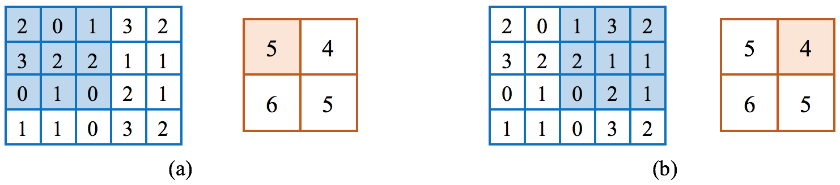
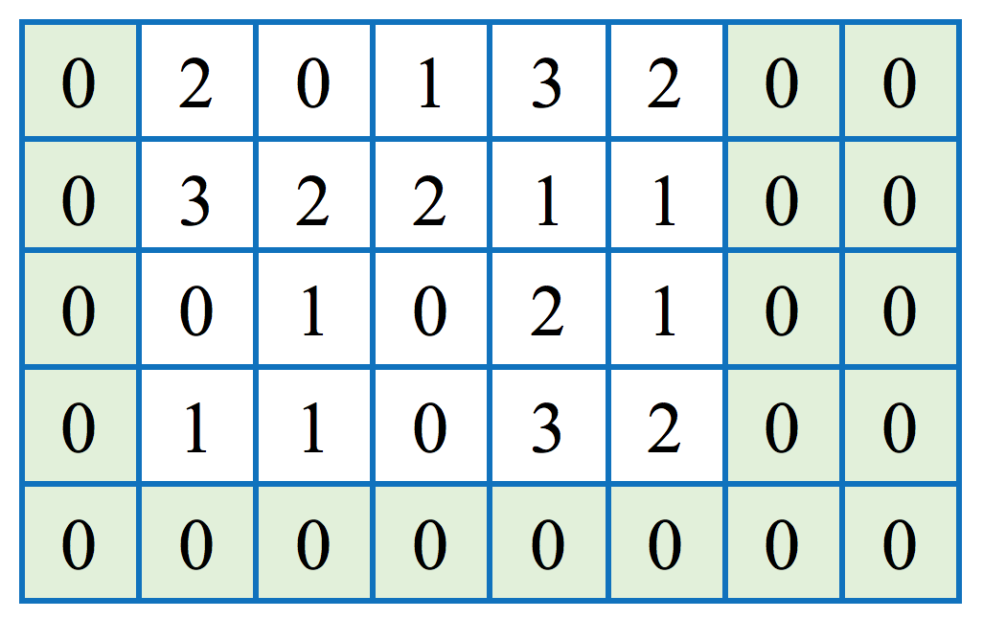
Convolution – Parameters
To resize the output matrix, we need two parameters:
Stride
Padding

Slide 10
Convolution – Stride
The default stride for lateral movement is 1.
To downsize the output matrix, we can set a stride greater than 1.
As shown above, we can use 2 strides for lateral movement and 1 stride for longitudinal movement.

Slide 11
Convolution – Padding
To increase the size of the output matrix, we can pad one row of 0s (false pixels), one column of 0s, and two columns of 0s on the lower, left, and right sides of the original matrix.
Padding helps increase the size of the output matrix.
The kernel function can be calculated around the edge pixels.
In convolution calculation, the size of the output matrix can be controlled based on the stride and padding parameters.

Slide 12
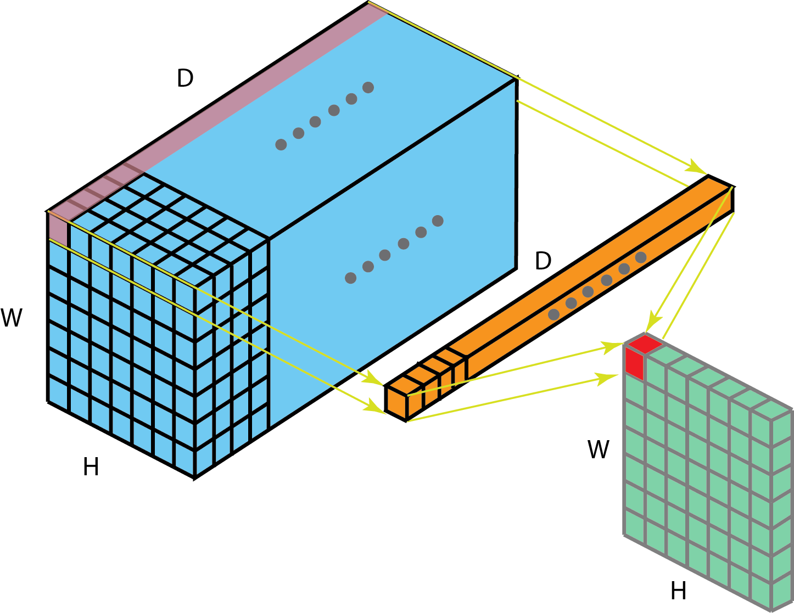
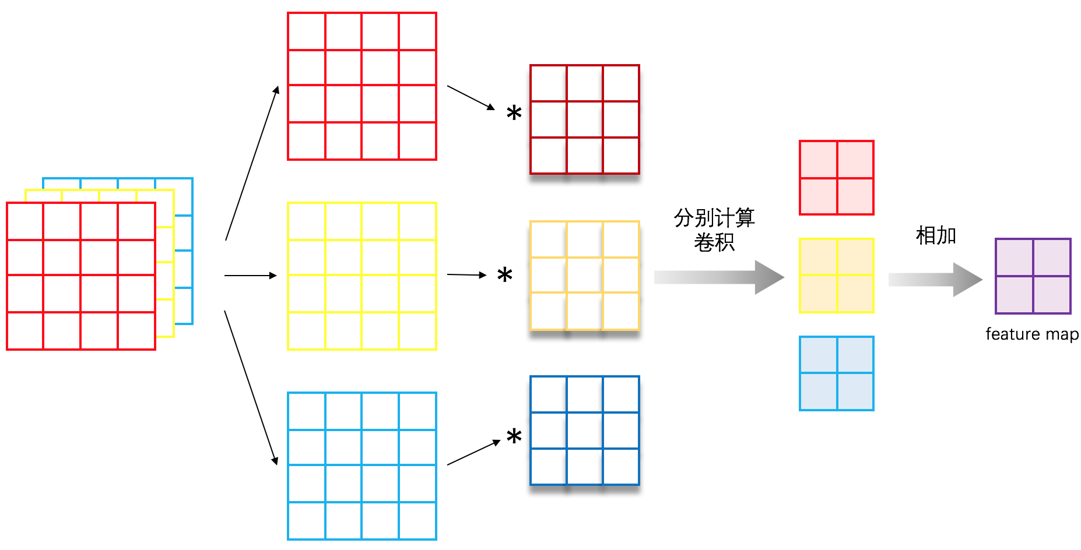
Convolution – Multi-channel
We can superimpose multiple identical input and kernel matrices together.
An image usually includes three channels that represent the three primary colors: red, green, and blue.(RGB)
If the number of input channels is c₁ and the number of output channels is c₂, a total of c₁×c₂ kernel matrices are needed.
Separate convolution
Sum

Slide 13
Contents
Convolution
Pooling
LeNet 5
Other mainstream CNN models

Slide 14
Pooling – Introduction
We can reduce the size of output matrices by increasing strides. Another common method for such reduction is pooling.
Two types: max-pooling and mean-pooling
4
5
1
0
2
5
Max-pooling
3
4
4
1
0
1
1
3
2
0
1.5
2
3
1
0
4
Mean-pooling
2
1.5

Slide 15
Pooling – Features
Max-pooling
Max-pooling can obtain local information and preserve texture features more accurately.
Max-pooling is ideal if we want only to determine whether an object appears in an image, not if we want to observe the specific location of the object in the image.
Mean-pooling
Mean-pooling can usually preserve the features of the overall data. It is more suitable for highlighting background information.
Through pooling, some unimportant information is discarded, while information that is more important and more favorable to a particular task is reserved.
Pooling can reduce dimensionality and computational complexity.

Slide 16
Pooling – Relationships with Kernel Matrices
Pooling also supports the multi-channel, stride, and padding parameters.
Pooling is performed on a single matrix.
Convolution is a kernel matrix operation on an input matrix.

Slide 17
Contents
Convolution
Pooling
LeNet 5
Other mainstream CNN models

Slide 18
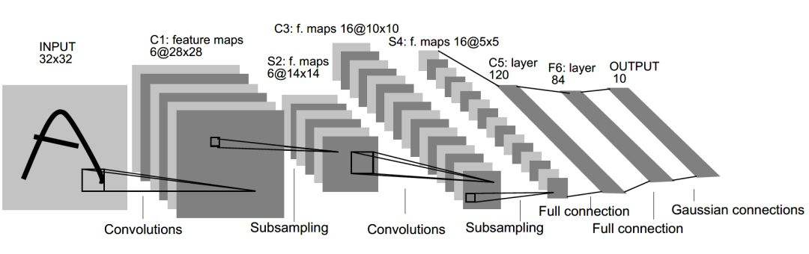
LeNet
Convolutional layer (first layer in this example)
The input is a 1×32×32 grayscale image.
We can first use six 5×5 convolution kernels to obtain a 6×28×28 feature map.
Pooling layer (second layer in this example)
After dimensionality reduction, we obtain a 6×14×14 feature map.
Fully connected layer
Finally, we obtain an output vector, that is, a category expression.
Notes:
https://gitee.com/mindspore/course/tree/master/lenet5

Slide 19
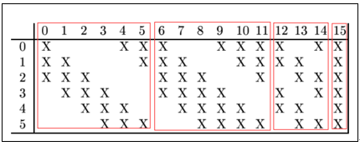
LeNet
step | transfer | Input size | Output size | Kernel numbers | Kernel/Pooling window size | stride | Active function
1 | Input→C1 | 32*32*1 | 28*28*6 | 6 | 5*5*1 | 1 | Sigmod/tanh
2 | C1→S2 | 28*28*6 | 14*14*6 | / | 2*2 | 2 | Average pooling
3 | S2→C3 | 14*14*6 | 10*10*16 | 6 6 3 1 | 5*5*3 5*5*4 5*5*4 5*5*6 | 1 | Sigmod/tanh
4 | C3→S4 | 10*10*16 | 5*5*16 | / | 2*2 | 2 | Average pooling
5 | S4→C5 | 5*5*16 | 1*1*120 | 120 | 5*5*16 | / | Sigmod/tanh
6 | C5→F6 | 120 | 84 | / | / | / | Sigmod/tanh
7 | F6→Output | 84 | 10 | / | / | / | Softmax
……
……
…
84
10
120
https://tensorspace.org/html/playground/lenet.html
Step 3 details

Slide 20

Application: Image Classification – MNIST
MNIST handwritten digit recognition is a classic application of image classification. Each image is a 28×28 grayscale image.
The input layer has 784 values, and the fully connected network needs a large number of parameters, potentially leading to overfitting.
Through parameter sharing of convolution kernels, model parameters are reduced.

Slide 21
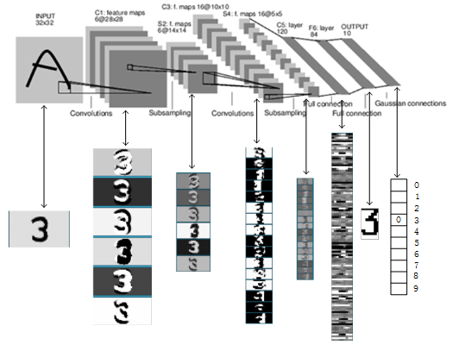
Application: Image Classification – MNIST
Extract the contour information of a numeral image through lower convolution kernels.
Reduce the dimensionality of the image and abstract the information into features that the computer can understand.
Classify the digits through fully connected layers.

Slide 22
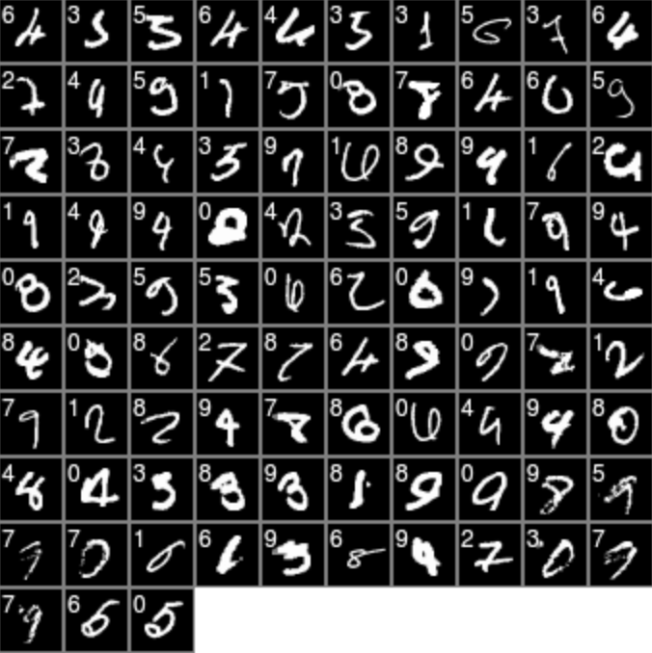
Application: Image Classification – MNIST
Among the images misclassified by neural networks, many also difficult for humans to identify. This indicates that CNNs have actually learned the semantics of digits in images.
Misclassified MNIST images
Digits in the upper left corners are model-predicted labels.

Slide 23
Contents
Convolution
Pooling
LeNet 5
Other mainstream CNN models
AlexNet
VGGNet
GoogLeNet
ResNet

Slide 24
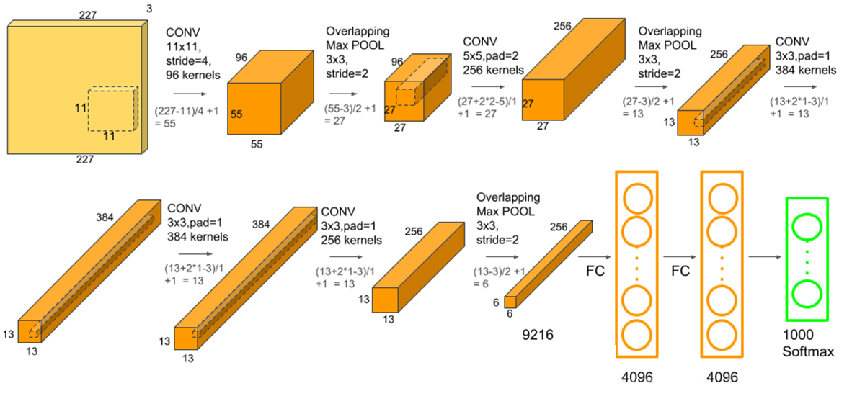
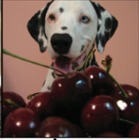
Other mainstream CNN models: AlexNet
AlexNet is the first milestone in CNN development.
The classification accuracy on ImageNet dataset is significantly improved than traditional image classification methods.
The AlexNet model has eight layers (excluding input layer), including five convolution layers and three full connection layers. Relu is used as the activation function, and softmax is used for classification output in the last layer.
Input image
size:227*227*3
Output is a category out of 1000
A. Krizhevsky, I. Sutskever, and G. Hinton. Imagenet classification with deep convolutional neural networks. In NIPS, 2012.
https://tensorspace.org/html/playground/alexnet.html

Slide 25
Other mainstream CNN models: AlexNet
step | transfer | Input size | Output size | Kernel numbers | Kernel/Pooling window size | stride | Active function | Padding
1 | Input→C1 | 227*227*3 | 55*55*96 | 96 | 11*11*3 | 4 | ReLU | 0
2 | C1→S2 | 55*55*96 | 27*27*96 | / | 3*3 | 2 | / | 0
3 | S2→C3 | 27*27*96 | 27*27*256 | 256 | 5*5*96 | 1 | ReLU | 2
4 | C3→S4 | 27*27*256 | 13*13*256 | / | 3*3 | 2 | / | 0
5 | S4→C5 | 13*13*256 | 13*13*384 | 384 | 3*3*256 | 1 | ReLU | 1
6 | C5→C6 | 13*13*384 | 13*13*384 | 384 | 3*3*384 | 1 | ReLU | 1
7 | C6→C7 | 13*13*384 | 13*13*256 | 256 | 3*3*384 | 1 | ReLU | 1
8 | C7→S8 | 13*13*256 | 6*6*256 | / | 3*3 | 2 | / | 0
9 | S8→F9 | 6*6*256 | 4096 | 4096 | 6*6*256 | / | ReLU | 0
10 | F9→F10 | 4096 | 4096 | / | / | / | ReLU | 0
7 | F10→Output | 4096 | 1000 | / | / | / | Softmax | 0

Slide 26
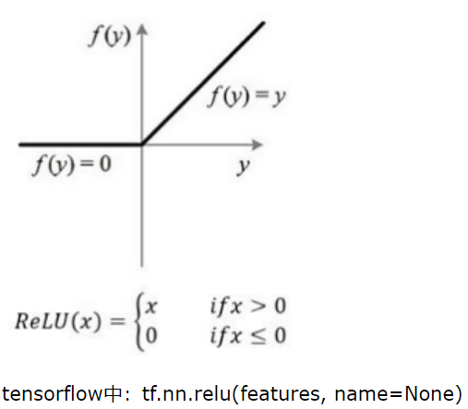
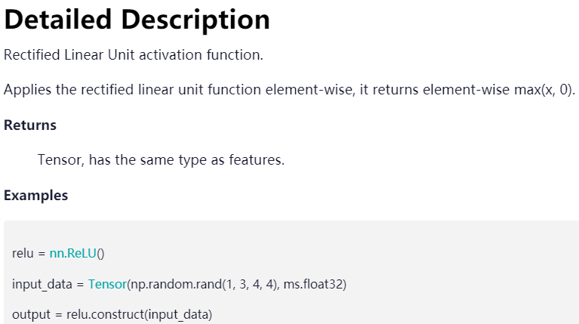
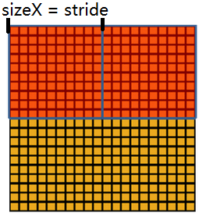
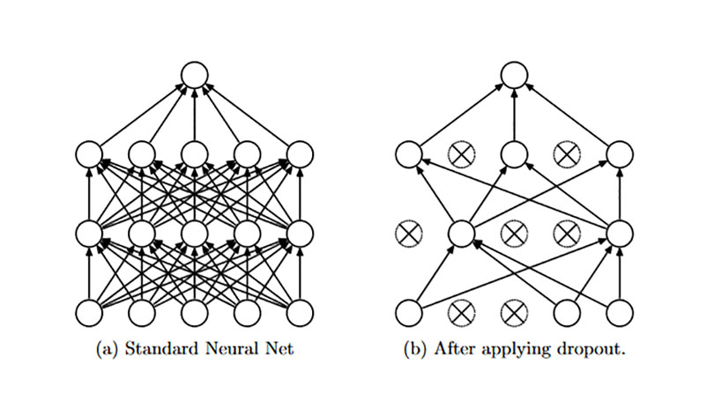
Other mainstream CNN models: AlexNet
1. Using ReLU instead of Sigmoid to solve the problem of gradient vanishing
2. Using dropout to avoid overfitting
3. Proposing and using maximum overlap pooling to slow down overfitting
Window size=3, stride=2 vs Window size=stride=2
Reducing error rate: top1 0.4% and top5 0.3%
Note: top5 error means that the correct label is not in the first five answers predicted by the model
https://zhuanlan.zhihu.com/p/42914388

Slide 27
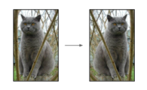
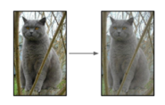
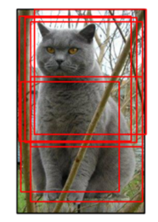
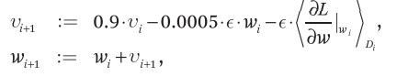
Other mainstream CNN models: AlexNet
4. Data augmentation
5. stochastic gradient descent optimization algorithm with a small batch size and momentum
Horizontal flip
Random clipping, translation and rotation
Color transformation
https://pic4.zhimg.com/80/v2-8fb090a42fd0a53bdb90c81586cc3a63_720w.jpg
https://pic2.zhimg.com/80/v2-22bf80fd3c54bef4d21e2fb6d6222e99_720w.jpg
https://img-blog.csdn.net/20180320113147375?watermark/2/text/aHR0cDovL2Jsb2cuY3Nkbi5uZXQvdTAxMTU3NDI5Ng==/font/5a6L5L2T/fontsize/400/fill/I0JBQkFCMA==/dissolve/70/gravity/SouthEast

Slide 28
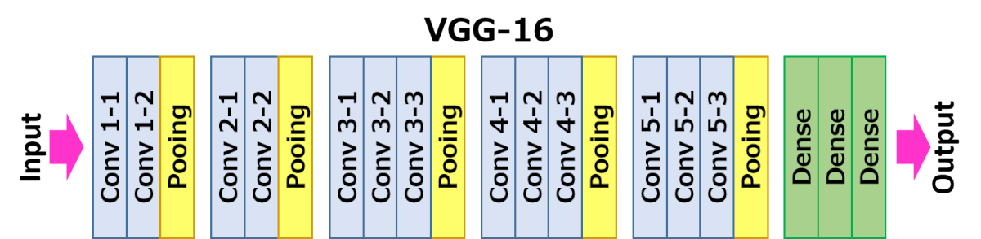

Other mainstream CNN models: VGGNet
VGG16 & VGG19
The same size convolution kernel size (3x3) and maximum pooling size (2x2) are used in the whole network.
Replacing large convolution kernels with cascaded small convolution kernels.
The disadvantage is the large amount of parameters.
https://www.mdpi.com/sensors/sensors-19-01486/article_deploy/html/images/sensors-19-01486-g001-550.jpg
Simonyan K, Zisserman A. Very deep convolutional networks for large-scale image recognition[J]. arXiv preprint arXiv:1409.1556, 2014.

Slide 29
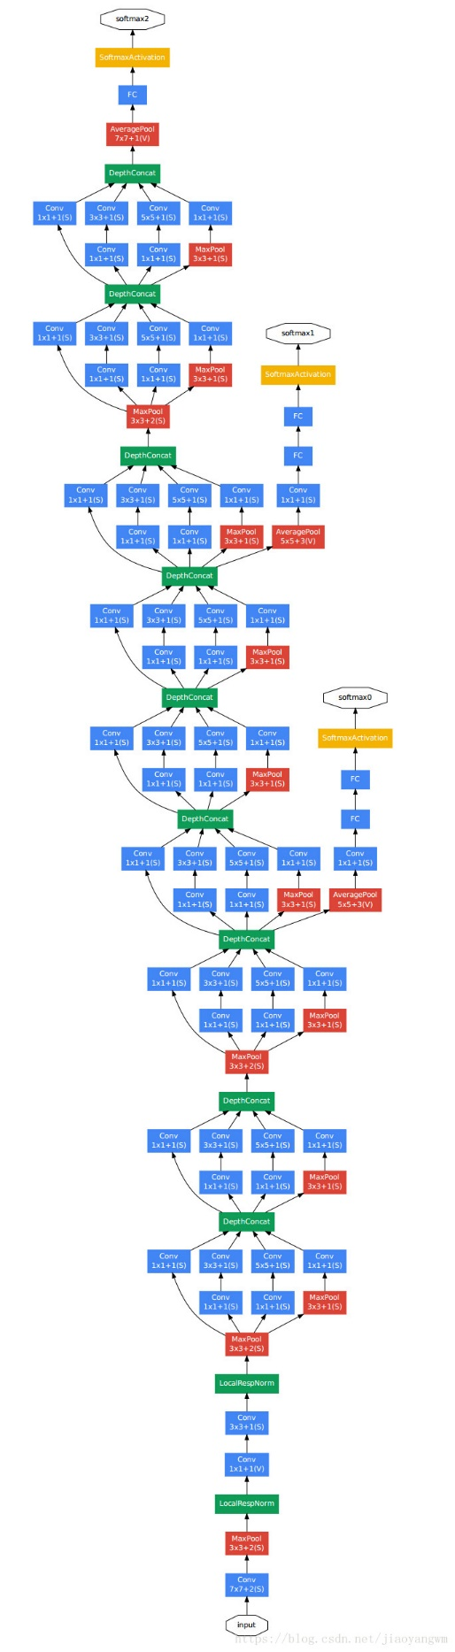
Other mainstream CNN models: GoogLeNet
The first model to introduce the concept that CNN layers do not need to be stacked sequentially all the time.
Although GoogLeNet increases network depth and width, it reduces parameters.
Parallelize some operations
The final full connection layer is removed and replaced by a global average pooling
Several visions
【naïve Inception, inception v1】Szegedy C, Liu W, Jia Y, et al. Going deeper with convolutions[C]//Proceedings of the IEEE conference on computer vision and pattern recognition. 2015: 1-9.
【Inception v2, Inception v3】Szegedy C, Vanhoucke V, Ioffe S, et al. Rethinking the inception architecture for computer vision[C]//Proceedings of the IEEE conference on computer vision and pattern recognition. 2016: 2818-2826.
【Inception v4、Inception-ResNet】Szegedy C, Ioffe S, Vanhoucke V, et al. Inception-v4, inception-resnet and the impact of residual connections on learning[C]//Thirty-first AAAI conference on artificial intelligence. 2017.
https://img-blog.csdn.net/20150319150219047?watermark/2/text/aHR0cDovL2Jsb2cuY3Nkbi5uZXQvbHlubmFuZHdlaQ==/font/5a6L5L2T/fontsize/400/fill/I0JBQkFCMA==/dissolve/70/gravity/Center

Slide 30
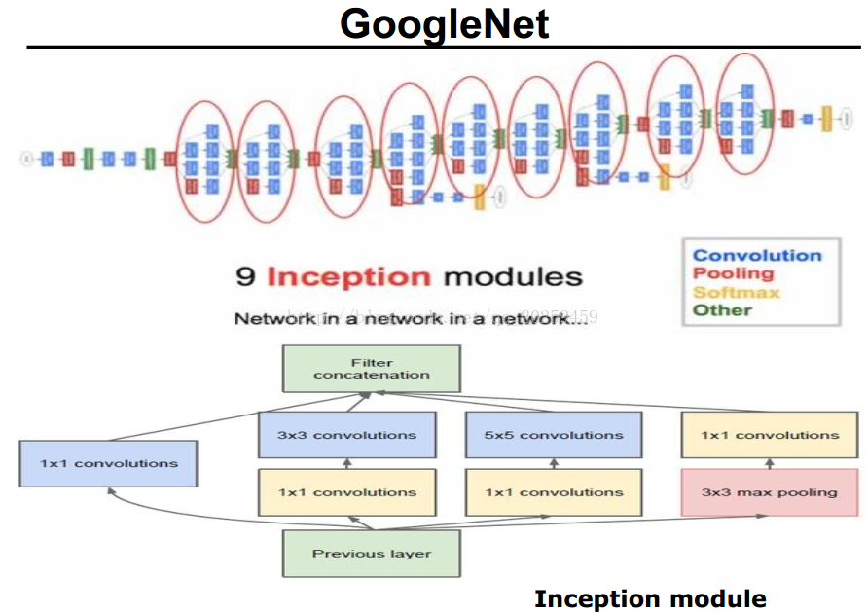
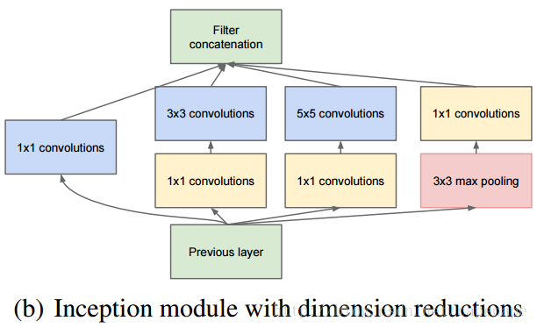
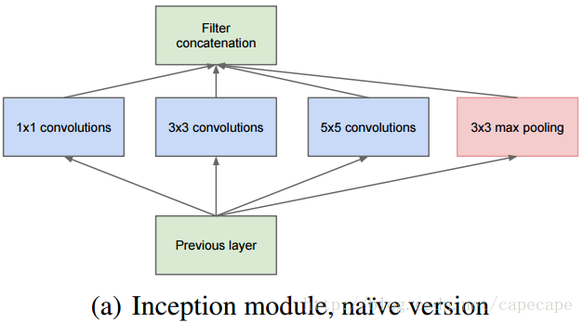
Other mainstream CNN models: GoogLeNet
9 identical Inception modules
The main idea of Inception structure is how to use dense components to approximate the optimal local sparse structure.
Inception module has different visions
https://img-blog.csdn.net/20171021114313531?watermark/2/text/aHR0cDovL2Jsb2cuY3Nkbi5uZXQvY2FwZWNhcGU=/font/5a6L5L2T/fontsize/400/fill/I0JBQkFCMA==/dissolve/70/gravity/SouthEast
https://img-blog.csdn.net/20171021114808706?watermark/2/text/aHR0cDovL2Jsb2cuY3Nkbi5uZXQvY2FwZWNhcGU=/font/5a6L5L2T/fontsize/400/fill/I0JBQkFCMA==/dissolve/70/gravity/SouthEast

Slide 31
ResNet – Depth Problem
By increasing the number of layers in CNNs, we are able to extract deeper and more general features.
When the number of network layers increases, gradient disappearance or explosion may occur, making it difficult to train networks.
Residual networks (ResNet) can solve the depth problem.

Slide 32
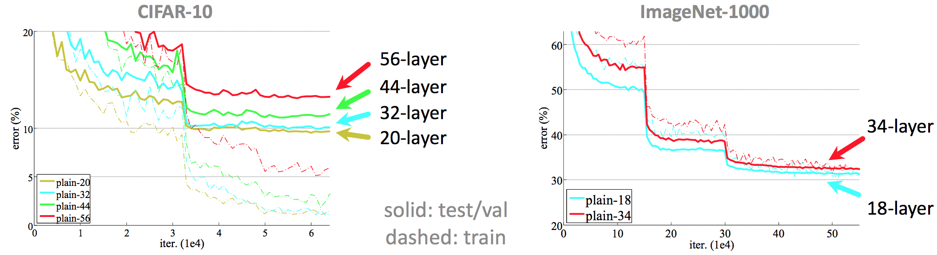
ResNet – Depth Problem
Directly increasing depth will make training more difficult and cannot achieve the expected effect.
This has been proven on multiple datasets.

Slide 33
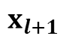
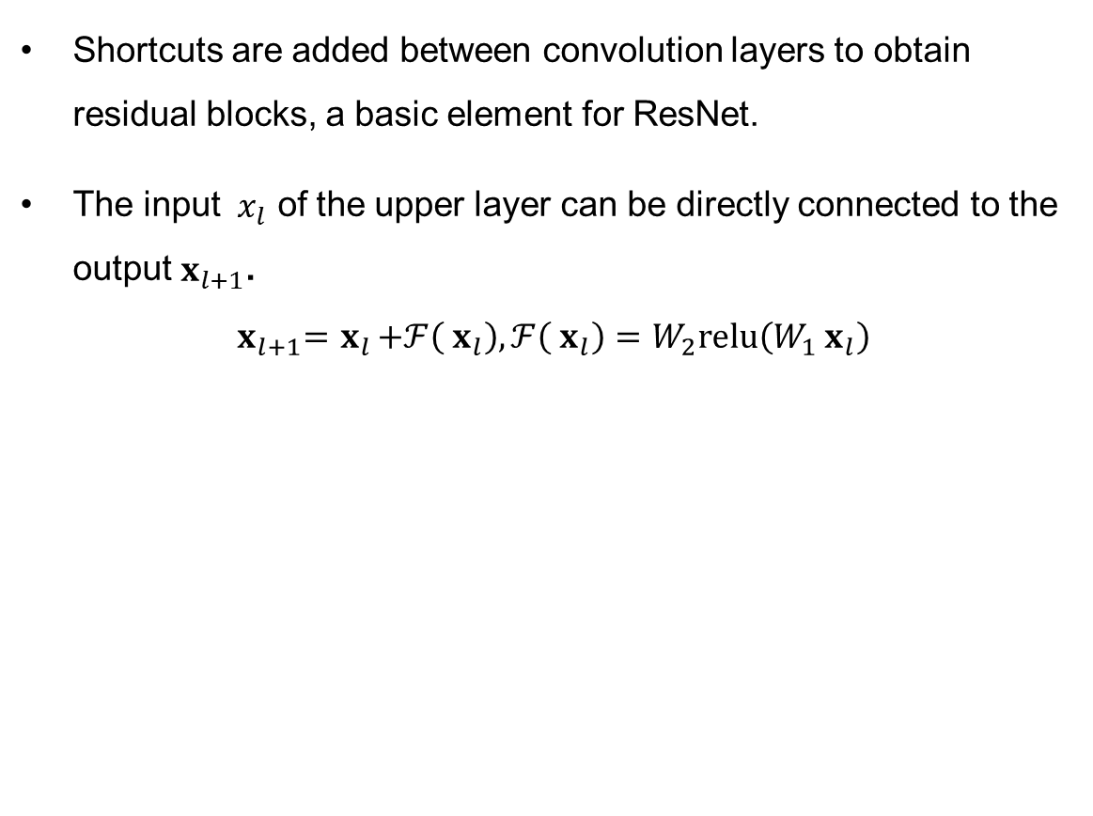
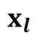

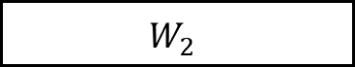
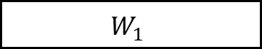
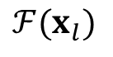
ResNet – Residual Block
Shortcuts are added between convolution layers to obtain residual blocks, a basic element for ResNet.
The input ${ x}_{l}$ of the upper layer can be directly connected to the output $x_{l+1}$.
$${ x}_{l+1}={ x}_{l}+ℱ\left({ x}_{l}\right), ℱ\left({ x}_{l}\right)=W_{2}relu\left(W_{1}{ x}_{l}\right)$$
$$x_{l}$$
$$W_{1}$$
ReLU
$$W_{2}$$
$$ℱ(x_{l})$$
$$+$$
$$x_{l+1}$$

Slide 34
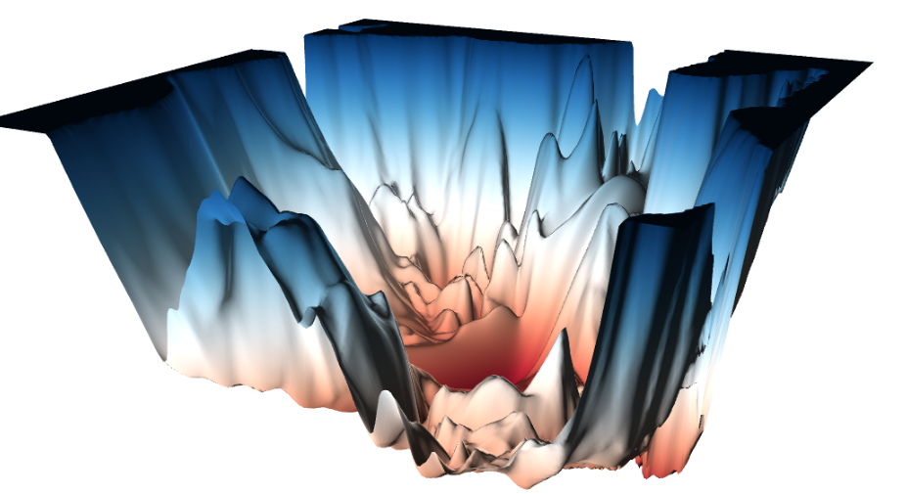
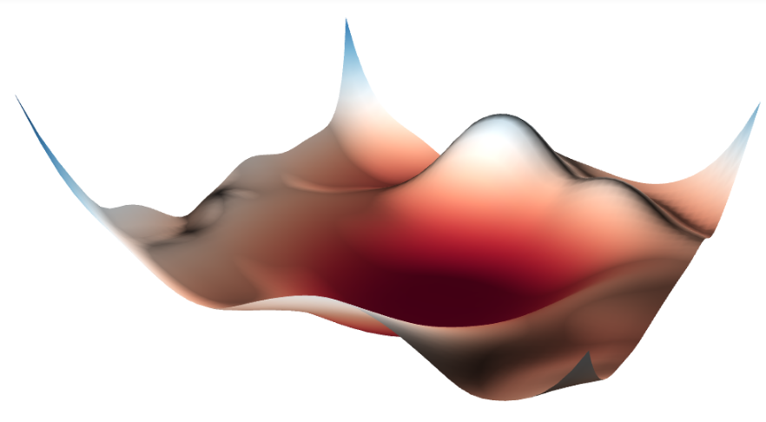
ResNet – Intuitive understanding
Which one do you think is easier to find the optimal solution?
ResNet56 (no short)
ResNet56 (short)

Slide 35
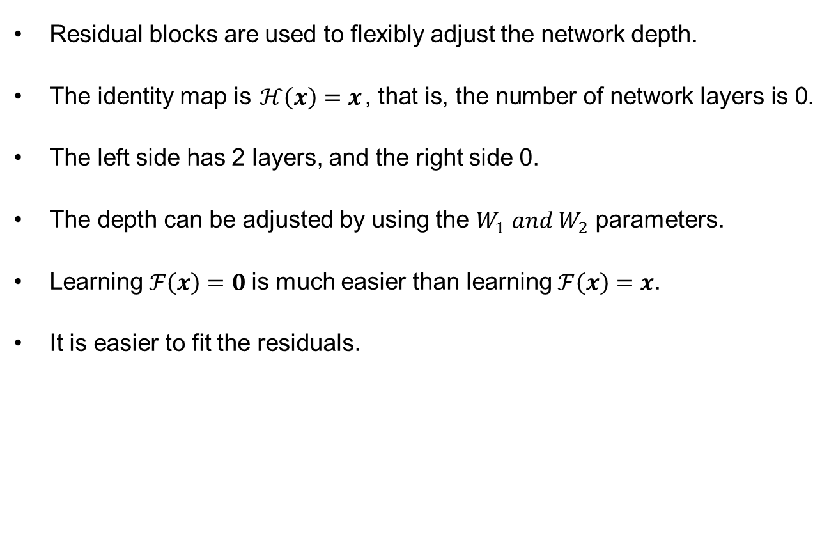
ResNet – Principles
Residual blocks are used to flexibly adjust the network depth.
The identity map is $ℋ\left(x\right)=x$, that is, the number of network layers is 0.
The left side has 2 layers, and the right side 0.
The depth can be adjusted by using the $W_{1} and W_{2}$ parameters.
Learning $ℱ\left(x\right)=0$is much easier than learning $ℱ\left(x\right)=x$.
It is easier to fit the residuals.
$$x_{l}$$
$$W_{1}$$
ReLU
$$W_{2}$$
$$ℱ(x_{l})$$
$$+$$
$$x_{l+1}$$

Slide 36
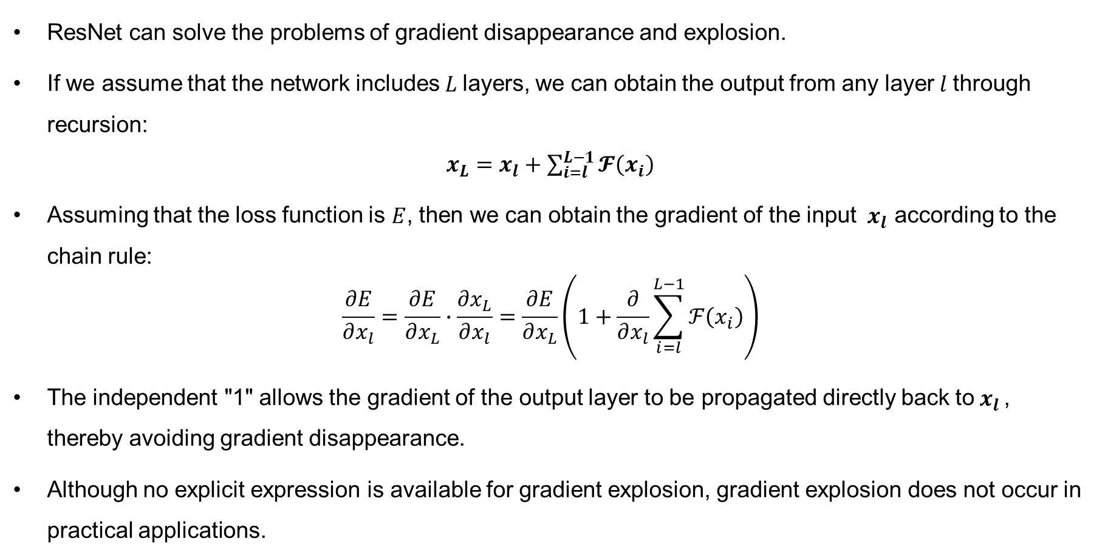
ResNet – Gradient
ResNet can solve the problems of gradient disappearance and explosion.
If we assume that the network includes$L$layers, we can obtain the output from any layer$l$through recursion:
$x_{L}=x_{l}+\sum_{i=l}^{L−1}{𝓕\left(x_{i}\right)}$
Assuming that the loss function is $E$, then we can obtain the gradient of the input ${ x}_{l}$ according to the chain rule:
$$\frac{∂E}{∂x_{l}}=\frac{∂E}{∂x_{L}}∙\frac{∂x_{L}}{∂x_{l}}=\frac{∂E}{∂x_{L}}\left(1+\frac{∂}{∂x_{l}}\sum_{i=l}^{L−1}{ℱ\left(x_{i}\right)}\right)$$
The independent "1" allows the gradient of the output layer to be propagated directly back to$x_{l }$, thereby avoiding gradient disappearance.
Although no explicit expression is available for gradient explosion, gradient explosion does not occur in practical applications.

Slide 37
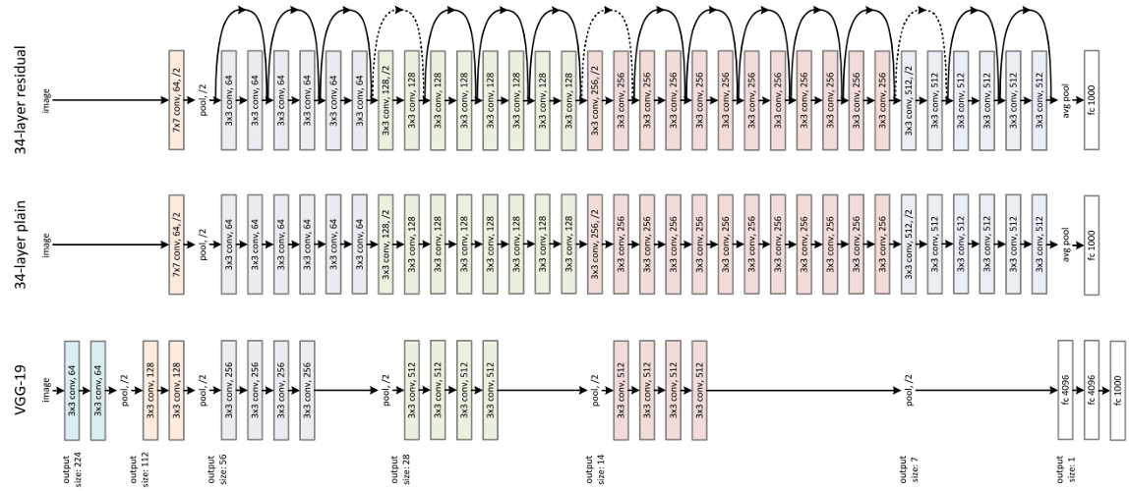
ResNet – Schematic Diagram
ResNet includes layers of residual blocks.
Each residual block adjusts the padded value to ensure that the number of input dimensions is equal to the number of output dimensions.
Shortcuts help to ensure the feasibility of model training.

Slide 38
Summary
Convolution: As a fundamental building of CNNs, convolution is like a sliding window that slides from left to right or from top to bottom. Each time the window slides from one point to another, a weighted mean value is obtained. It focuses on a small piece of data or local data.
Pooling: We can reduce the size of output matrices by increasing strides. Another common method for such reduction is pooling, including max-pooling and mean-pooling.
Mainstream CNN models: LeNet5, AlexNet, VGG, GoogLeNet, ResNet
Hands-on LeNet5

